Slide 1
FCE Bootcamp – March 2017 Application Architectures Week
Jeremy Beard | Principal Solutions Architect

Slide 2
Myself
Jeremy Beard
Principal Solutions Architect
Based in NYC
Cloudera for 4.5 years
jeremy@cloudera.com

Slide 3
What are we doing this week?
Learning hands on how to build applications on an EDH
Groups teaming up to keep the momentum going
Expanding out a single use case solution over the week
Simulating a customer engagement with real problem solving
Three sections
Ingestion and querying
Batch processing
Stream processing

Slide 4
Format of each section
Build out a solution to the high level requirements for the use case
Develop iteratively – start simple and add piece by piece
If you find something very easy, help someone else figure it out
Try to solve blockers as a group before reaching out
Also don’t get bogged down with an error for too long
Capture information about what you achieved, what worked well, what was challenging, and metrics such as performance
Each group to do an informal debriefing for the other groups

Slide 5
Section components
Ingestion and querying
Sqoop
HDFS
Impala
Hue
Batch processing
Oozie
Hive
Spark
Stream processing
Flume
Kafka
Spark Streaming
HBase
Kudu
Solr

Slide 6
Use case for the week
https://nyti.ms/2jRIEnF

Slide 7
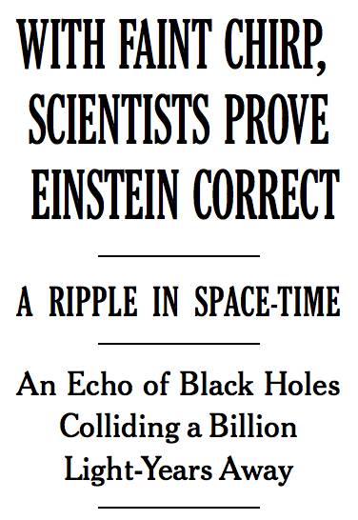
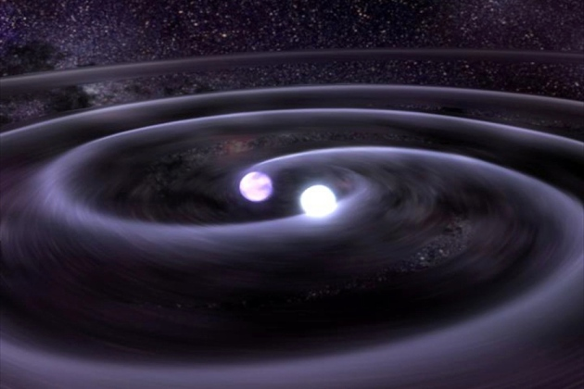
Use case for the week

Slide 8
Use case requirements
Find gravitational waves in astronomical detector measurements
Provide the measurement data set for end user querying
Make it easy to query for finding the gravitational waves
Make the queries run fast
Minimize the time for measurements to be available after they are made
Minimize the effort involved in loading new measurements

Slide 9
Use case data model
One record is one measurement
Each measurement is
At a point in time
Made up of three signal amplitudes
From a gravitational wave detector somewhere in the world
Being performed by an astrophysicist
Listening to a nearby galaxy
A gravitational wave is detected when the first and third amplitudes are > 0.995, and the second amplitude is < 0.005

